Slide 1
Introduction to MongoDB
MSA 8040: Data Management for Analytics
Houping Xiao
hxiao@gsu.edu

Slide 2
Overview
Data Management for Analytics
Section 1:
Introduction
Section 2:
MySQL
Section 3:
NoSQL
Section 4:
Web Scraping
Section 5:
Text Mining
Work Based Projects
Database
concepts
Design concepts
MySQL
Functions
Operators
NoSQL
Types
Pro & Con
Beautiful Soup
Regular
expression
Unstructured
data
Textual data
ER model
ER diagrams’
Normalization
MongoDB
CURD
Aggregation
Selenium
Navigating
Locating
elements
Topic Modeling
LDA
Dynamic LDA
SQL
Statement
syntax
Advanced SQL
Procedure
Trigger
Sentiment analysis
Neural network
SVM
Decision tree
Relational model
Twitter API
From Query to Analytics

Slide 3
MongoDB overview
Document-oriented data model, easier to split up data across multiple servers
Consists of pairs of (key, document)
Key—a string, services for queries
Document—data structure composed of field : value
Automatically takes care of
Balancing data and load across a cluster
Redistributing documents automatically
Routing user requests to the correct machines

Slide 4
Key features
MongoDB’s replica sets provide both automatic failover and data redundancy
High Availability
Automatic Scaling
High Performance
High performance data persistence:
embedded data models to reduce I/O activity
Indexes for faster queries
Keys from embedded documents & arrays
Horizontal scalability
Automatic sharding distributes data across a cluster of machines
Replica sets provide eventually-consistent

Slide 5
Core components of MongoDB
Mongod – the primary process
Mongod handles data requests, manages data access, and performs background management operations
Mongos – utilized as a routing service for MongoDB Shard configurations.
Mongos processes queries from the application layer and determines the data’s location in the sharded cluster so as to complete the commanded operations
Mongo (client) – an interactive JavaScript shell interface for MongoDB and provides an interface to test queries and operations directly within the database.

Slide 6
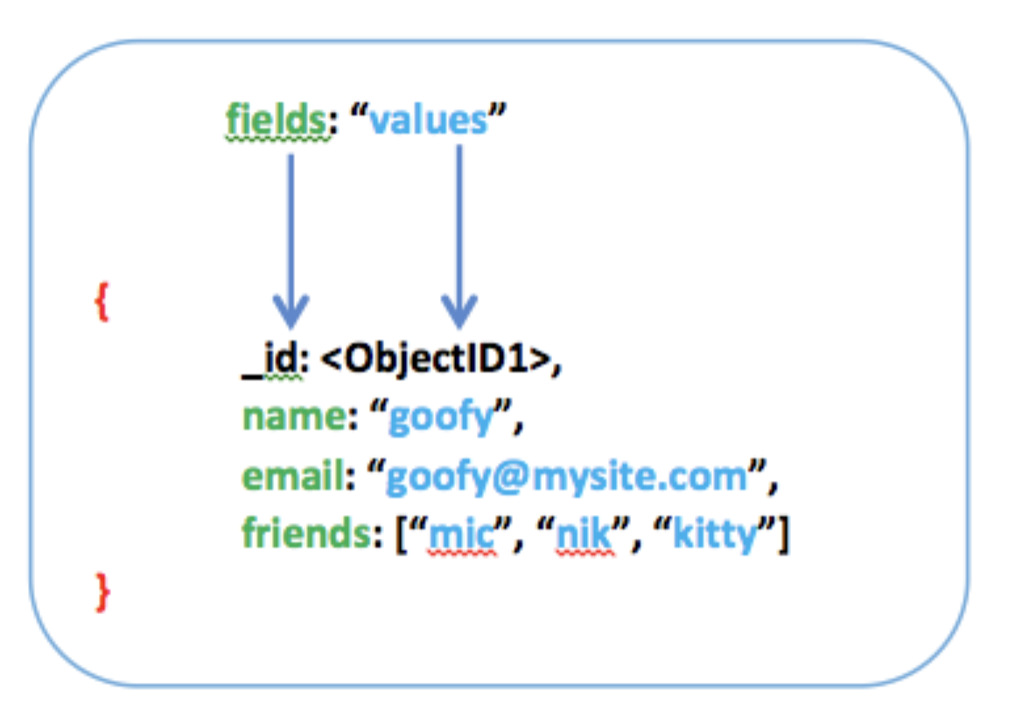
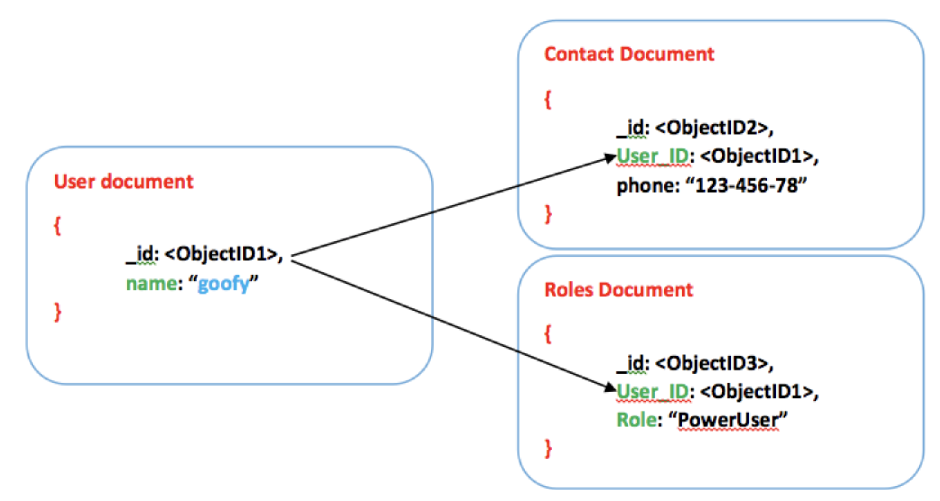
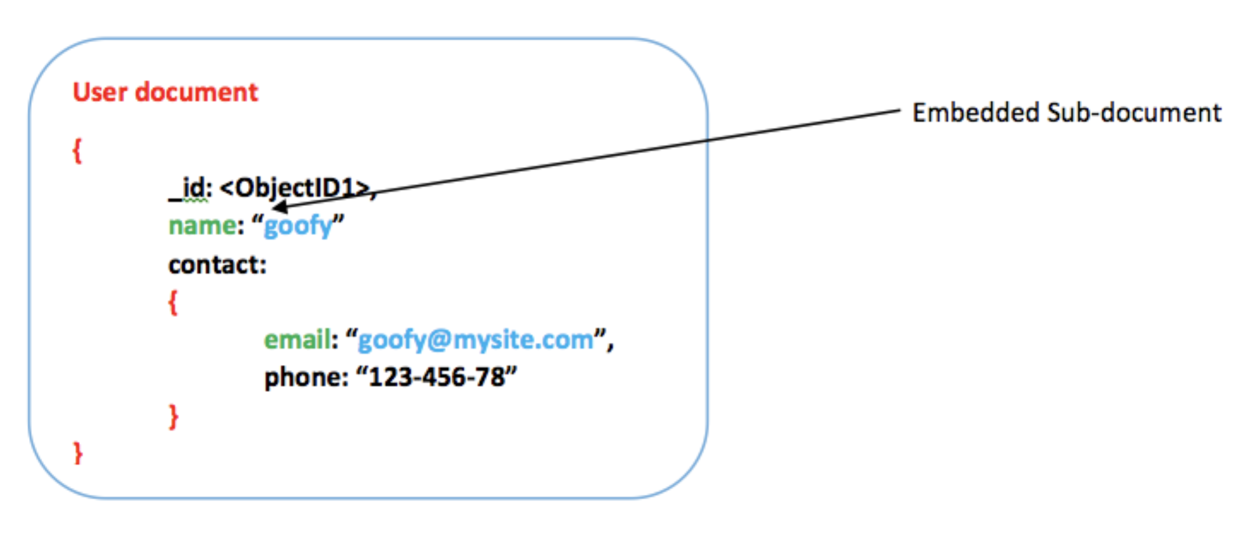
Documents in MongoDB
A record in MongoDB is a document, a data structure composed of field and value pairs
The value may include other documents, arrays, and arrays of documents
MongoDB use BSON, a binary-encoded serialization of JSON-like documents,
lightweight, traversable, and efficient, and support embedding of objects and arrays
Document
Referenced Documents
Embedded documents

Slide 7
Concepts mapping from RDBMS to MongoDB
RDBMS |  | MongoDB
database | → | database
Table, view | → | collection
row | → | Document (BSON)
column | → | Field
index | → | index
join | → | Embedded document
Foreign key | → | reference
partition | → | shard

Slide 8
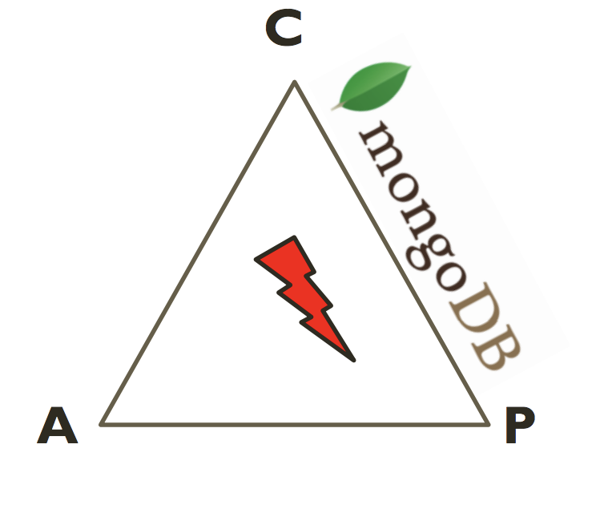
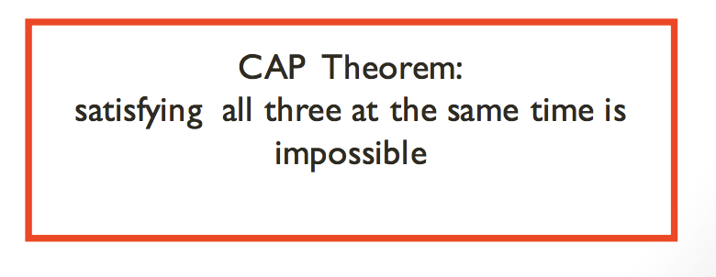
MongoDB: CAP
Focus on Consistency
and Partition tolerance
Consistency
All replicas contain the same version of the data
Availability
System remains operational on failing nodes
Partition tolerance
Multiple entry points
System remains operational on system split

Slide 9
MongoDB uses replication to balance AC
Replication: keep identical copies of data on multiple servers to keep applications running and data safe
A Replica set with Replication cluster
A Replica set with Arbiter
Primary
(Mongodb process)
Primary
(Mongodb process)
pings
/2s
pings
/2s
no data
Secondary
(Mongodb process)
Secondary
(Mongodb process)
Secondary
(Mongodb process)
Arbiter
(Mongodb process)

Slide 10
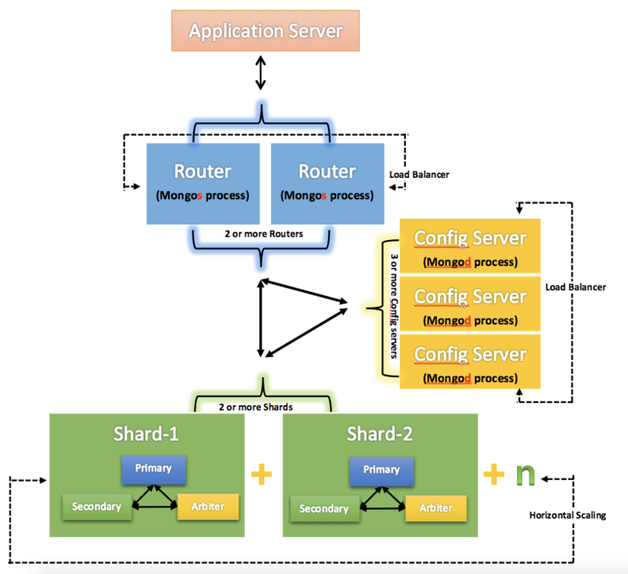
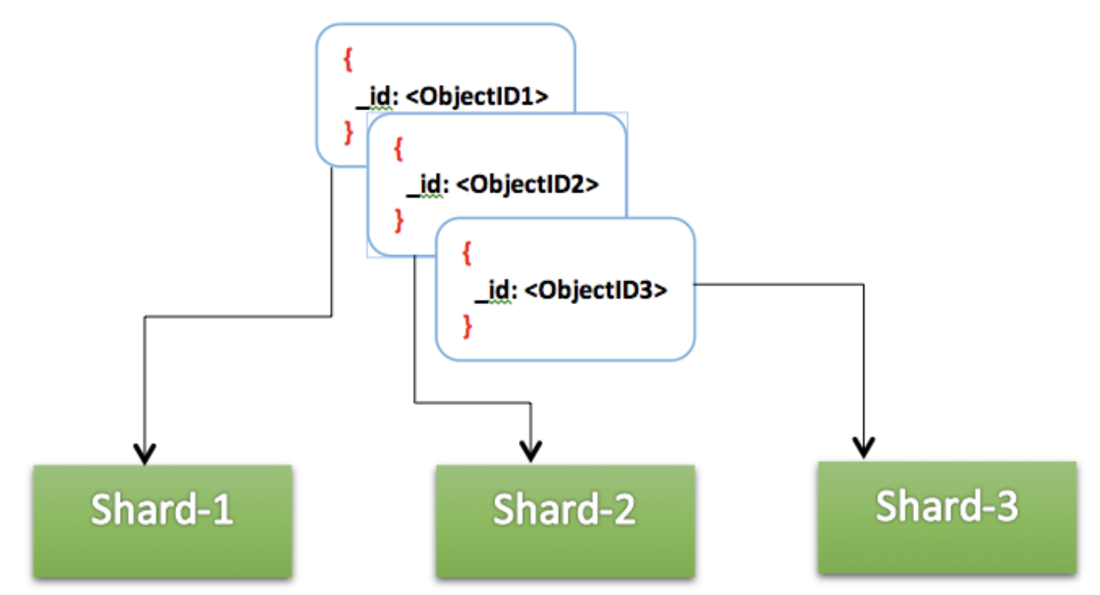
MongoDB uses sharding to distribute Data
Sharding: break up a collection into subsets of data and store them across multiple shards
requests
Meta data
which data should be extracted from which shard
Each collection is stored in multiple parts across multiple shards
a replica set holds portion of data
Notes:
Sharding: break up a collection into subsets of data and store them across multiple shards

Slide 11
MongoDB CRUD operations
CRUD: Create, Read, Update, & Delete
In MongoDB, Create, Update & Delete operations target a single collection. All write operations in MongoDB are atomic on the level of a single document.

Slide 12
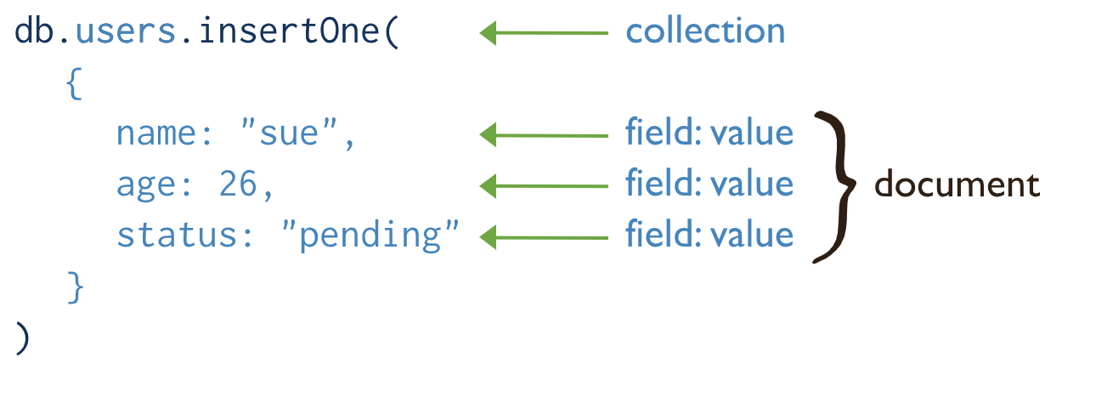
MongoDB CRUD operations: Create
Create or insert operations add new documents to a collection. If the collection does not currently exist, insert operations will create the collection.
db.collection.insertOne()
db.collection.insertMany()
Notes:
In MongoDB, insert operations target a single collection. All write operations in MongoDB are atomic on the level on a single document

Slide 13
MongoDB CRUD operations: Read
Retrieves documents from a collection; i.e. queries a collection for documents. To read documents from a collection:
db.collection.find()

Slide 14
Query operators
https://docs.mongodb.com/manual/reference/operator/query/

Slide 15
Query documents
To specify equality conditions, use <field>:<value> expressions
AND
select all documents in the collection
OR
the status equals "A" and either qty is less than ($lt) 30 or item starts with the character p

Slide 16
MongoDB CRUD operations: Update
Modify existing documents in a collection:
db.collection.updateOne()
db.collection.updateMany()
db.collection.replaceOne()
Specify criteria, or filters, that identify the documents to update. These filters use the same syntax as read operations.
Notes:
All write operations in MongoDB are atomic on the level of a single document.

Slide 17
MongoDB CRUD operations: Delete
Delete operations remove documents from a collection. MongoDB provides the following methods to delete documents of a collection:
db.collection.deleteOne()
db.collection.deleteMany()
Notes:
In MongoDB, delete operations target a single collection. All write operations in MongoDB are atomic on the level of a single document.

Slide 18
Query an array
To specify conditions on the elements in the array field, use
Documents where tag array contains at least one “red”
Exact Array to match: including the order of the elements
If we do not care the order of elements, use $all

Slide 19
Query an array
To specify conditions on the elements in the array field, use
At least one single element satisfies the condition $gt 25
Either one single element meets these condition or any combination of array elements meet the conditions
$elemMatch: at least one array element meets all the conditions

Slide 20
Query an array
Query for an Element by the Array Index Position, zero-based indexing
Query an Array by Array Length

Slide 21
Query on embedded/nested documents
To specify an equality condition on a field that is an embedded/nested document, use the query filter document {<field>: <value> } where <value> is the document to match
Equality matches on the whole embedded document require an exact match of the specified <value> document, including the field order

Slide 22
Query on embedded/nested documents
Query on Nested Field
To specify a query condition on fields in an embedded/nested document, use dot notation("field.nestedField").
Specify Equality Match on a Nested Field
The following example selects all documents where the field uom nested in the size field equals "in":
Specify Match using Query Operator
{ <field1>: { <operator1>: <value1> }, ... }
Specify AND Condition

Slide 23
Query an array of embedded documents
Use the Array Index
$elemMatch: A Single Nested Document Meets Multiple Query Conditions on Nested Fields
Combination of Elements Satisfies the Criteria
selects all documents where an element in the instock array matches the specified document:
An exact match of the specified document, including the field order.
Specify a Query Condition on a Field Embedded in an Array of Documents:
instock array has at least one embedded document that contains the field qty whose value is less than or equal to 20
Notes:
If you do not know the index position of the document nested in the array, concatenate the name of the array field, with a dot (.) and the name of the field in the nested document
Use $elemMatch operator to specify multiple criteria on an array of embedded documents such that at least one embedded document satisfies all the specified criteria.

Slide 24
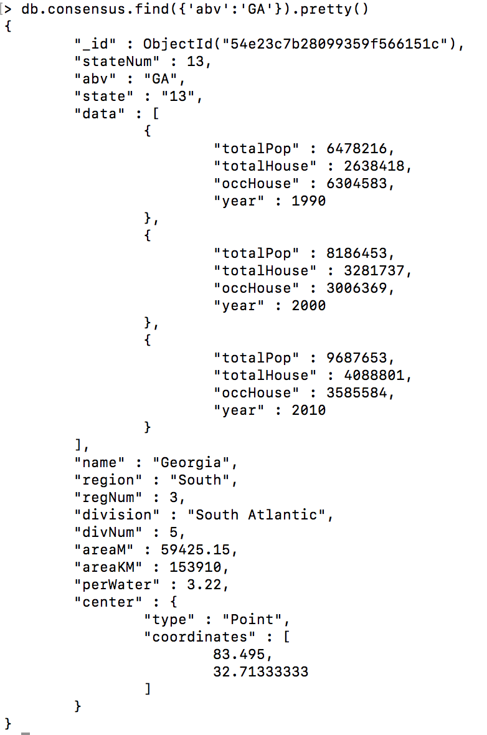
How aggregation works in MongoDB: an example
Division = a group of US States
Population density = area of division / population
Data is provided at the state level
Document For Each State
Name
Region
Division
Census Data For 1990, 2000, 2010
Population
Housing Units
Occupied Housing Units
Census Data is an array with three subdocuments
Which US Division has the fastest growing population density?
population >= 1M
Area KM >= 100K

Slide 25
How will we solve it in MySQL?
GROUP BY + HAVING + LIMIT
How about MongoDB?
Aggregation

Slide 26
Aggregation framework is easy: pipeline construction
https://dilbert.com/search_results?terms=framework

Slide 27
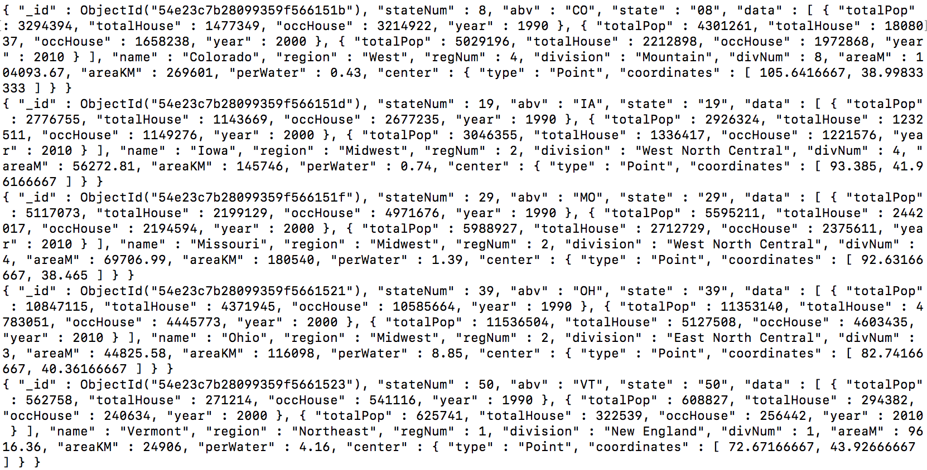
What & How to build an aggregation pipeline?
A Collection
Aggregation Pipeline
A cursor/Collection
Pipeline
$match
$project
$group
$sort
$match output→ $project input
Notes:
Rich library of functions
Filter, compute, group, and summarize data
Output of one stage sent to input of next
Operations executed in sequential order

Slide 28
An aggregation pipeline example
db.orders.aggregate([
{ $match : { ”status” : “A”} },
{ $group : {“_id” : “$cust_id”, “total” : {“$sum” : “$amount” } } }
])
{
“cust_id”:”A123”,
“amount”: 500,
“status”: “A”
}
{
“cust_id”:”A123”,
“amount”: 500,
“status”: “A”
}
{
“cust_id”:”A123”,
“amount”: 250,
“status”: “A”
}
{
“_id”:”A123”,
“total”: 750
}
$match
{
“cust_id”:”A123”,
“amount”: 250,
“status”: “A”
}
$group
{
“cust_id”:”B212”,
“amount”: 200,
“status”: “A”
}
{
“_id”:”B212”,
“amount”: 200
}
{
“cust_id”:”B212”,
“amount”: 200,
“status”: “A”
}
{
“cust_id”:”A123”,
“amount”: 300,
“status”: “D”
}

Slide 29
Pipeline operators
$match | Filter documents
$project | Reshape documents
$group | Summarize documents
$unwind | Expand documents (for array type)
$sort | Order documents (1: asc, -1 : desc)
$limit, $skip | Paginate documents
$redact | Restrict documents
$geoNear | Proximity sort documents
$let, $map | Define variables

Slide 30
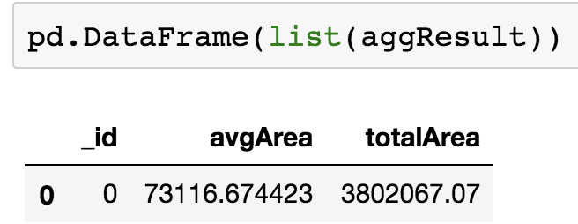
Calculate total area
$group
Group documents by value:
Field reference, object, constant
Other output fields are computed:
$max, $min, $avg, $sum
$addToSet, $push
$first, $last

Slide 31
Calculate total area by region
{
“state” : ”New York”,
“areaM”: 218,
“region”: “North East”
}
{ $group : {
“_id” : ”$region”,
“avgAreaM”: {”$avg” :
“$areaM” }
}
{
“state” : ”New Jersey”,
“areaM” : 90,
“region”: “North East”
}
{
“_id” : ”North East”,
“avgAreaM” : 154
}
{
“state” : ”California”,
“areaM” : 300,
“region” : “West”
}
{
“_id” : ”West”,
“avgAreaM” : 300
}
{ $group : {
“_id” : ”$region”,
“totArea”: {”$sum” :
“$areaM” },
“sCount” : {“$sum” : 1}
}
{
“_id” : ”North East”,
“totArea” : 308,
“sCount” : 2
}
{
“_id” : ”West”,
“totArea” : 300,
“sCount” : 1
}
$push
add the value into an array

Slide 32
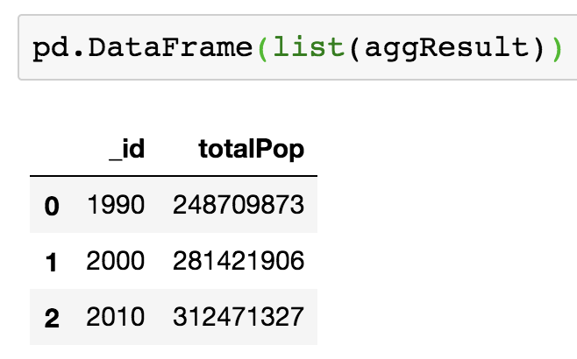
Calculate US population by year
$unwind
Operate on an array field:
Crate documents from array elements
Array replaced by element value
Missing/empty fields → no output
Non-array fields → error
Pipe to $group to aggregate
{
“state” : ”New York”,
“census”: [1990, 2000, 2010]
}
{ “$unwind” : “$census}
{
“state” : ”New Jersey”,
“census”: [1990, 2000]
}
{ “state” : “New York”,
”census” : 1990}
{ “state” : “New Jersey”,
”census” : 1990}
{ “state” : “California”,
”census” : 1990}
{
“state” : ”California”,
“census”: [1980, 1990, 2000, 2010]
}
{ “state” : “New York”,
”census” : 2000}
{ “state” : “New Jersey”,
”census” : 2000}
{ “state” : “California”,
”census” : 2000}
{ “state” : “New York”,
”census” : 2010}
{ “state” : “California”,
”census” : 1980}
{ “state” : “California”,
”census” : 2010}

Slide 33
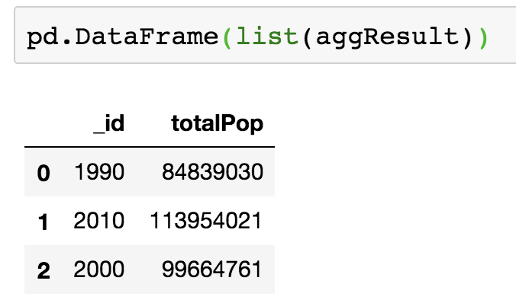
Calculate southern sate population by year
$match
Filter documents
Uses existing query syntax
No $where
{
“state” : ”New York”,
“areaM”: 218,
“region”: “North East”
}
{ $match: {
“region” : North East” }
}
{
“state” : ”New Jersey”,
“areaM” : 90,
“region”: “North East”
}
{
“state” : ”New York”,
“areaM”: 218,
“region”: “North East”
}
{
“state” : ”California”,
“areaM” : 300,
“region” : “West”
}
{
“state” : ”New Jersey”,
“areaM” : 90,
“region”: “North East”
}

Slide 34
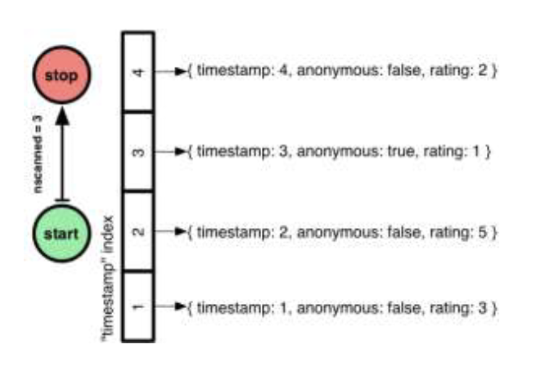
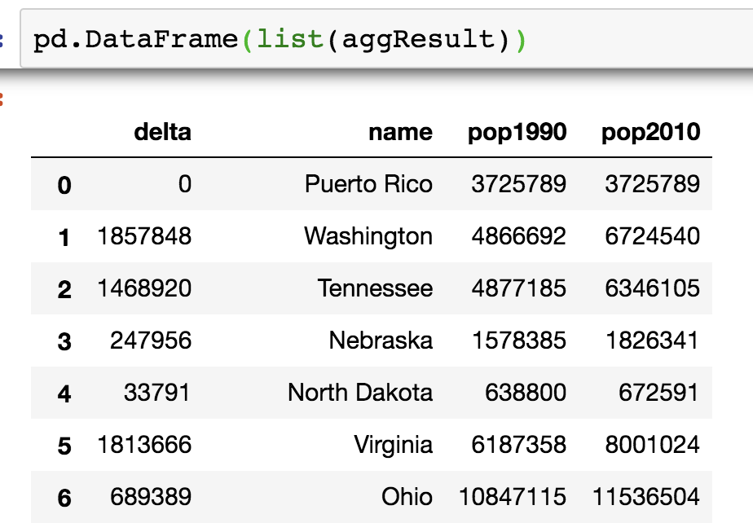
Calculate population delta by state between 1990 and 2010
$sort, $limit, $skip
$first, $last
Collection operations like $push and $addToSet
Must be used in $group
$first and $last determined by document order
Typically used with $sort to ensure ordering is known

Slide 35
Calculate population delta by state between 1990 and 2010
$project
Reshape Documents
Include, exclude or rename fields
Inject computed fields
Create sub-document fields
{
“_id” : ”Virginia”,
“pop1990”: 453588,
“pop2010”: 3725789
}
{ “$project”: {
“_id” : 0,
“pop1990” : 1,
“pop2010” : 1}
}
{
“name”: Virginia,
“delta”: 1813666
}
{ “$project”: {
“_id” : 0,
“name” : “$_id”,
“delta” : {“$subtract” : [“$pop2010”, “pop1990]},
“pop1990” : 1,
“pop2010” : 1}
}
{
“_id” : ”South Dakota”,
“pop1990”: 696004,
“pop2010”: 814180
}
{
“name”: South Dakota,
“delta”: 118176
}
{
“pop1990”: 453588,
“pop2010”: 3725789
}
{
“pop1990”: 696004,
“pop2010”: 814180
}

Slide 36
Calculate the total population of the area within 500KM of Memphis, TN in 1990, 2000, 2010, separately
$geoNear
Order/Filter Documents by Location
Requires a geospatial index
Output includes physical distance
Must be first aggregation stage
{
“_id” : ”Virginia”,
“pop1990”: 453588,
“pop2010”: 3725789,
”center” : {“type” : “point”,
“coordinates” : [78.6,37.5]}
}
{ “$geoNear”: {
“near” : {“type” : “points”,
“coordinates” : [90, 35]},
“maxDistance” : 500000,
“spherical” : true}
}
{
“_id” : ”Tennessee”,
“pop1990”: 4877185,
“pop2010”: 6346105,
”center” : {“type” : “point”,
“coordinates” : [86.6,37.8]}
}
{
“_id” : ”Tennessee”,
“pop1990”: 4877185,
“pop2010”: 6346105,
”center” : {“type” : “point”,
“coordinates” : [86.6,37.8]}
}
Save the results to a NEW collection

Slide 37
Which US division has the fastest growing population density? Focusing on Population >1M & totalAreaM>100K

Slide 38
Implement all Codes
Get the consensus data
Play with the Consensus Data Now.

